Slide 1
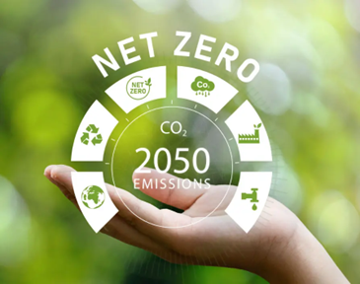
Journey to Net Zero (Carbon Emission): Technology Innovation to support SME’s
Chinedu Chukwuemeka mazi
A Data Scientist
Technology Sector?
Powered by Lloyds Bank
Net zero is the neutralisation of carbon emission with focus on SMEs using Technology innovation to reduce or end emission CO2 majorly, NO2 and CH4 negatively influences on climate end by 2050. SMEs contribute 99% of UK businesses, challenges faced, a guide to clarification on transition to net zero with a target Tech sector. Generally, every sector faces financial instability in budgeting and lower ROI, Control over emission outside personal activities and assessment, difficult to measure environment; the challenges will be simplified using my innovation (Machine Learning Analysis and Mobile Interface) eliminating of sensor activities which is operational expensive to compare to my system. The journey to achieving Net Zero emissions requires significant technological innovation across various sectors focusing technology, including the SME (Small and Medium-sized Enterprises) technology sector. SMEs play a crucial role in driving innovation, creativity, and the adoption of sustainable practices. To support their efforts in contributing to Net Zero goals, several key areas of focus are necessary: technology innovation, creativity, execution, design, and business model transformation

Slide 2
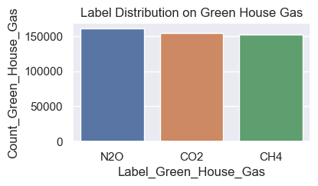
Technical Innovation
Assess the technological solutions employed to measure, monitor, and reduce carbon emissions, I was able to analyse the UK climate change dataset using ML algorithm (Random Forest) to predict greenhouse gas (CO2, NO2 and CH4) emitted using specified features. SMEs in the technology sector can drive innovation by developing and implementing sustainable technologies that reduce greenhouse gas emissions. My flutter application will leverage the predicted result type of gas emitted seen in next slide. eliminate the use of advanced sensors, IoT devices, adopting machine learning algorithms, and data analytics to gather accurate emission data and identify areas for improvement. The accuracy obtained was 74.7% which could be improve on by changing value max_depth and n_estimator. [1] Analyze the adoption of renewable energy sources, energy-efficient systems, carbon capture technologies, and sustainable transportation solutions

Slide 3
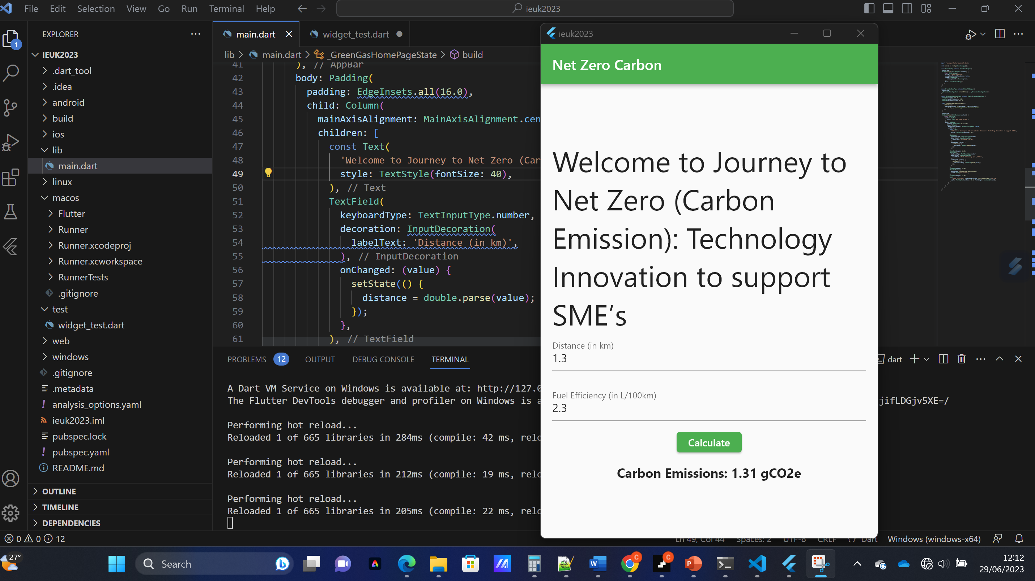
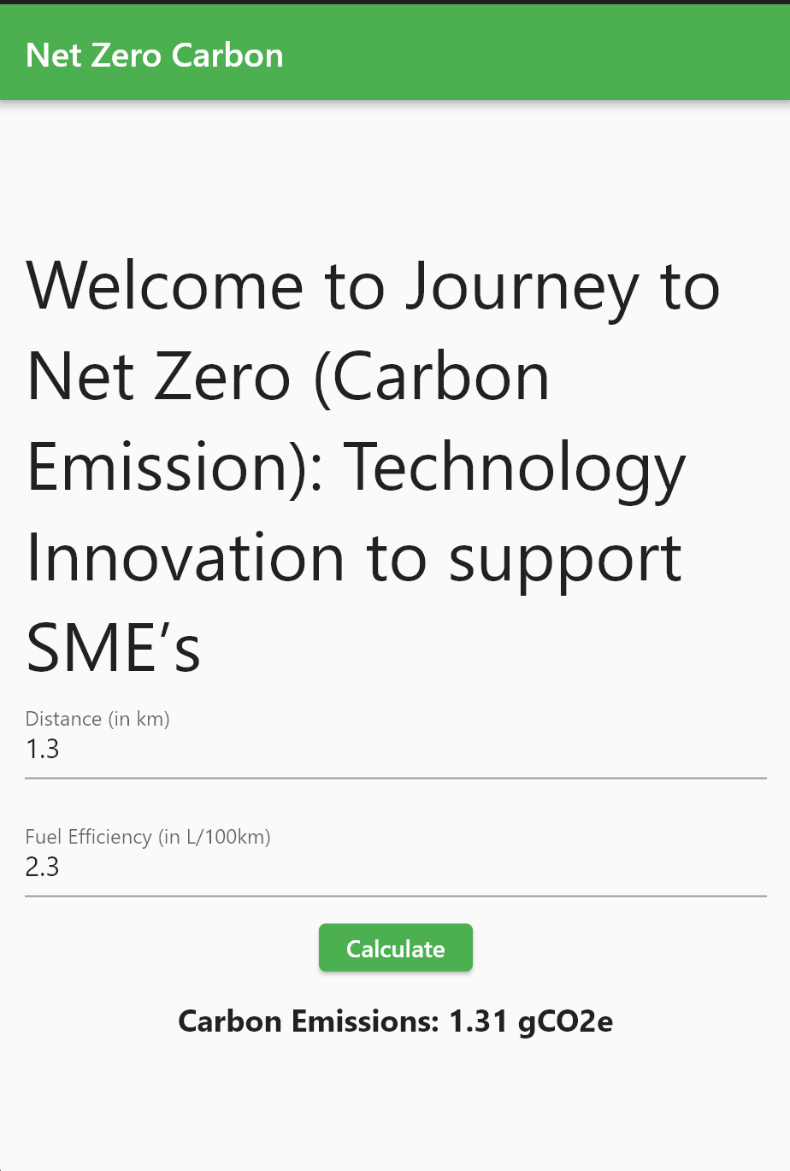
Creativity
I used jupyter notebook for data analysis and flutter framework to create my application. The backend bult with flask integrated the predict result to a real time response to notify user on number of carbon emitted. Creative thinking is essential for finding unique solutions to the challenges posed by the journey to Net Zero. SMEs can foster a culture of innovation and creativity by encouraging employees to think outside the box, experiment with new ideas, and embrace a mindset of continuous improvement. Cross-disciplinary collaboration and open dialogue within the organization can fuel creativity and lead to breakthrough innovations. My app calculates the number of carbon emitted. My solution Identified is novel approaches and out-of-the-box thinking which will address carbon emissions. Due to time constraints this Explore creative partnerships and collaborations that promote knowledge sharing and foster sustainable practices among SMEs, was not added

Slide 4
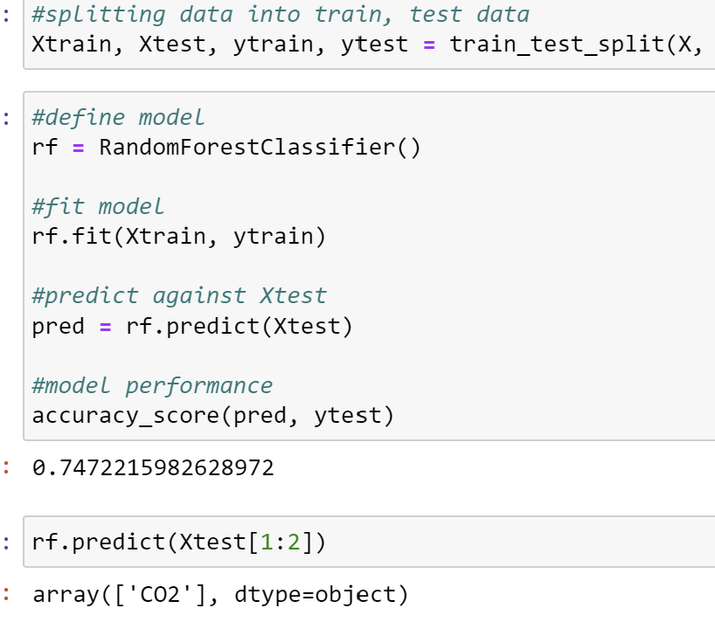
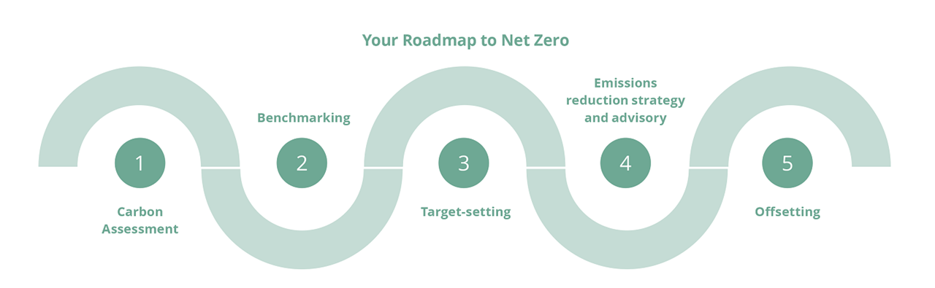
Execution, Design and Business Model
Execution:
I successfully, Evaluated my ML analysis and implementation of technology innovations usable in a real-world scenarios. case studies and examples where technology solutions have effectively reduced carbon emissions in SMEs. While ideas and concepts are crucial, effective execution is equally important. SMEs must focus on implementing sustainable technologies and practices within their own operations. This can involve adopting energy-efficient equipment, optimizing supply chains, reducing waste, and implementing sustainable procurement practices. Additionally, SMEs can collaborate with larger organizations, governments, and industry associations to execute joint projects that accelerate the transition to Net Zero.
Business Model:
Achieving Net Zero often requires fundamental shifts in business models. SMEs should evaluate their existing models and identify opportunities for transformation. SMEs will leverage my digital technologies solution to enhance efficiency, reduce waste, and optimize resource utilization. The system is feasibility, because within this 48 hours I achieved 50% , Yes, the system is scalable by adopting new technology and impact, it is win win afears UK and SMEs

Slide 5
Summary
Climate charge as result carbon emission mostly from SMEs business venture is a clear catalyst to global warming which leads to destructions of life and properties. My system will provide solution for SMEs transition to net zero following the outlined challenges, financing, assessment etc. My technical solutions will also provide cost-savings for SMEs, helping them to remain competitive and resilient. Furthermore, my solutions will facilitate the transition to a low-carbon transport system and help the UK to meet its climate change goals.
Link https://github.com/chinedunewbirth/IEUK-2023 find other resourse
#https://www.data.gov.uk/dataset/723c243d-2f1a-4d27-8b61-cdb93e5b10ff/uk-local-authority-and-regional-greenhouse-gas-emissions/datafile/d2c9d418-622c-45e4-a949-d586545949aa/preview

